Slide 1
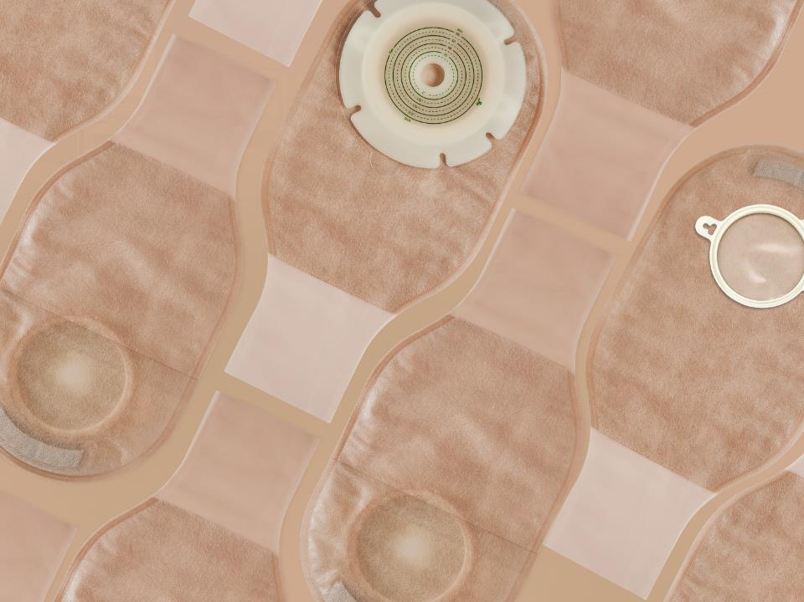

Ostomy Care Series
One Piece Open Ostomy Bag
Shanghai Joy Crown Industry Co., Ltd

Slide 2


What is an ostomy?
People who have ostomy surgery, usually with disease or cancer of the large bowel or rectum. During clinical treatment, an opening in the abdomen will be surgically used as a drainage channel to replace the anus. This opening is called an artificial stoma or artificial anus, it is called a stoma.
If an artificial stoma is made due to a disease of the urinary system, it is called a urostomy.

Slide 3
What is an ostomy bag?
According to the different stoma, the ostomy bag can be divided into Colostomy bag and urostomy bag.
An ostomy bag is used to store feces excreted by a stoma patient through the stoma，The ostomy bag is composed of a barrier and a bag body, the barrier makes the ostomy bag stick to the human body, and the bag body is used to store feces.
The bag body and barrier can be one piece, which is called a one-piece ostomy bag. The bag body and barrier can also be split, which is called a two-piece ostomy bag.
The ostomy bag can be divided into an open pocket and a closed pocket. The open pocket can discharge feces at any time through the opening of the bag body, and the closed pocket can be discarded when it is full, which is convenient to use.

Slide 4

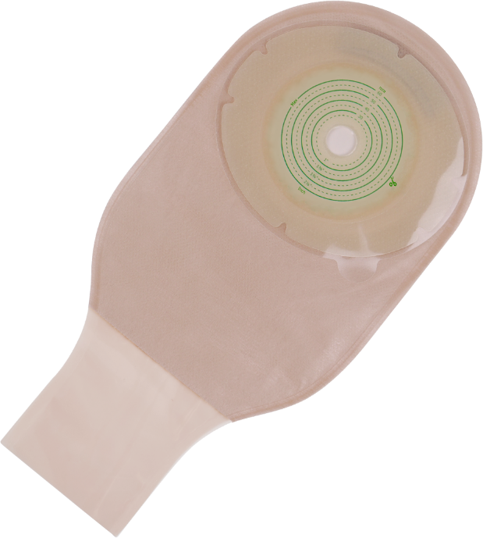
The Characteristics And Advantages Of Stoma Bag
1. Hydrocolloid barrier with unique formula and special design
Hydrocolloid Barrier
2. Soft and comfortable ultra-thin non-woven outer lining
Outer Lining Non-woven Fabric
3. Flexible, Sealed bag
The Bag Body
The experiment shows that the product is frmly pasted and is not afraid of leakage

Slide 5
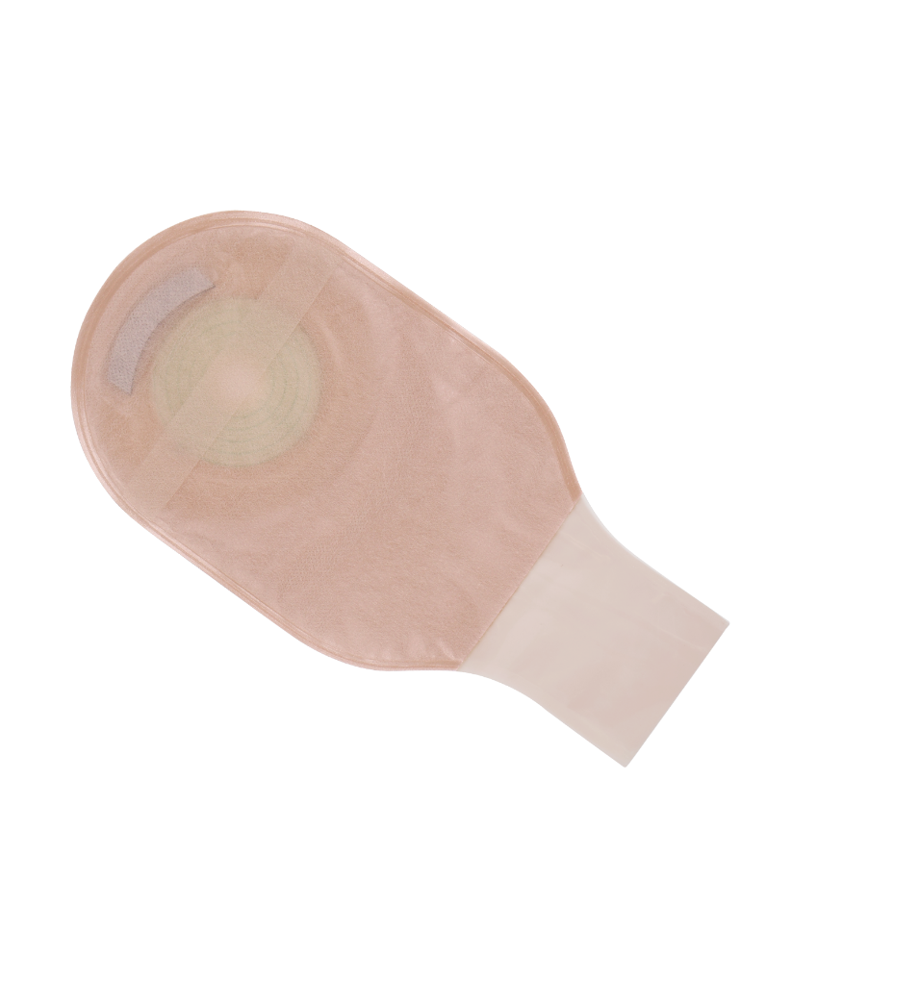

4. convenient observation
5. Activated carbon filter to effectively remove odors
6. Three sealing methods are availableodors
Activated Carbon Filter
View Port
Sealing

Slide 6
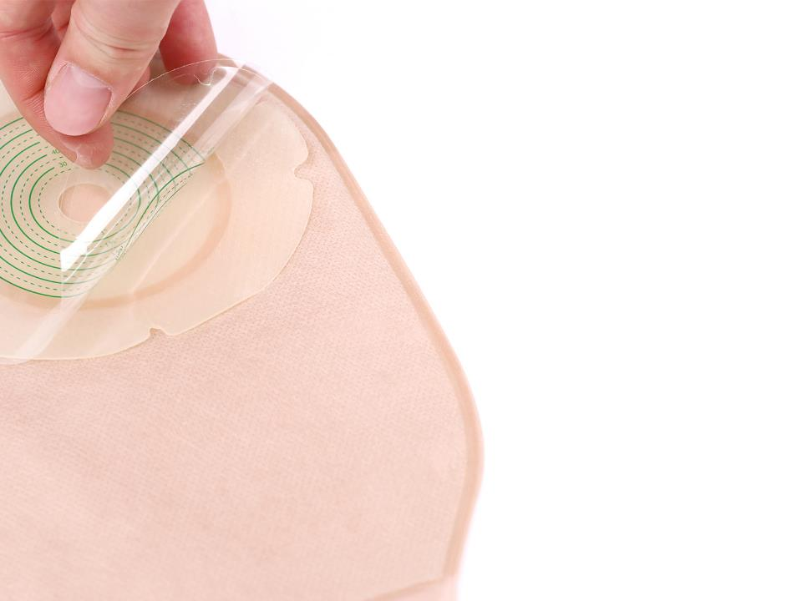
Hydrocolloid Barrier
Using medical hydrocolloid material, with no irritation and extremely low allergy rate.
Special hydrocolloid formula, with strong adhesive and safe and reliable.
Soft and comfortable, with radial incisions designed to conform to wrinkled skin with physical activity.
Easy to replace and clean.
Effectively absorbs the sweat produced by the skin, keeps it fresh and does not irritate the skin.

Slide 7
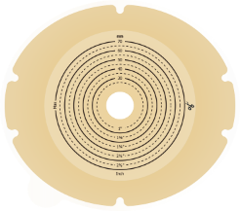

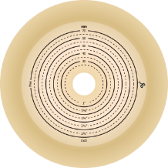
Three Barrier Styles To Fit Every Type Of Stoma
Hydrocolloid barrier
Hydrocolloid barrier
with tape border
Convex barrier

Slide 8
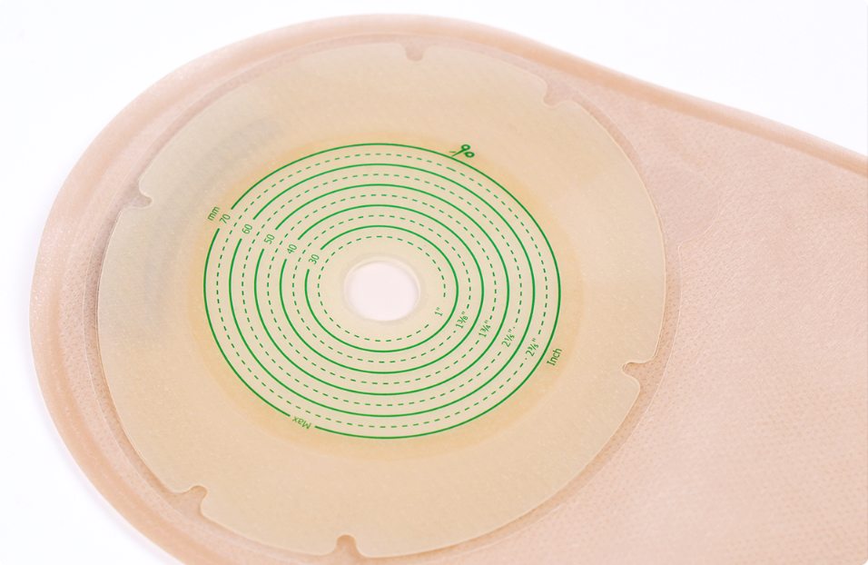
Hydrocolloid Barrier

Slide 9
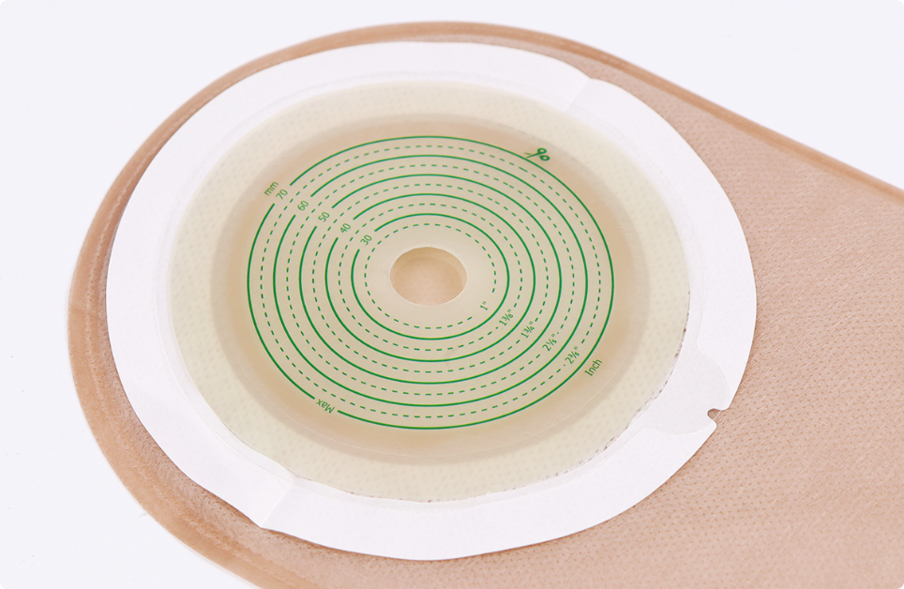
Hydrocolloid Barrier With Tape Border

Slide 10
Convex barrier

Slide 11
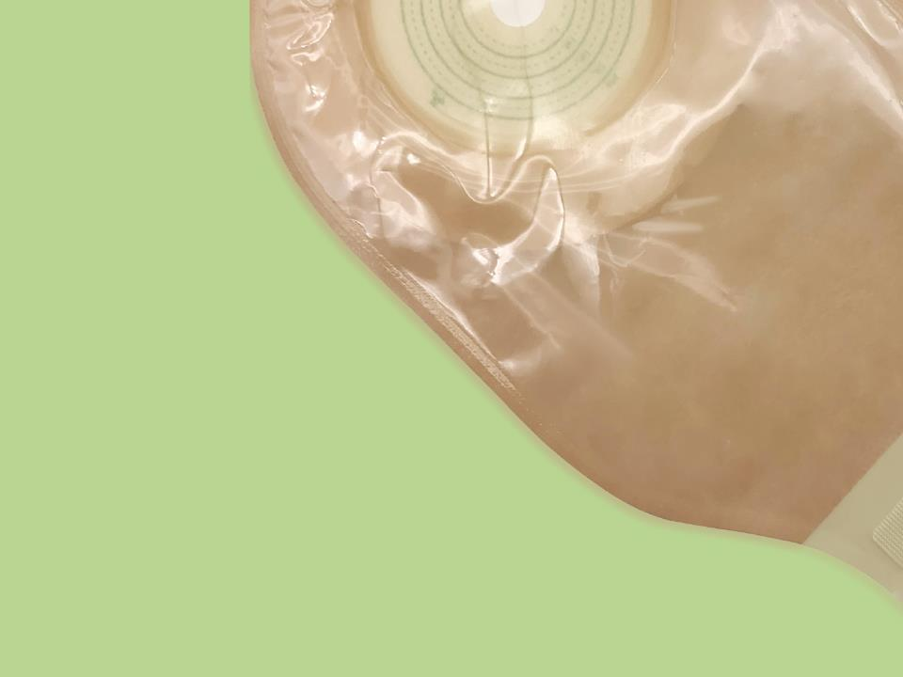
The Bag Body
* High barrier film, soft and strong
*Good airtightness and no leakage

Slide 12





A Variety Of Bag Styles Are Available For Patients Of Different Ages
Neonate
Children
Adult
Larger Size

Slide 13
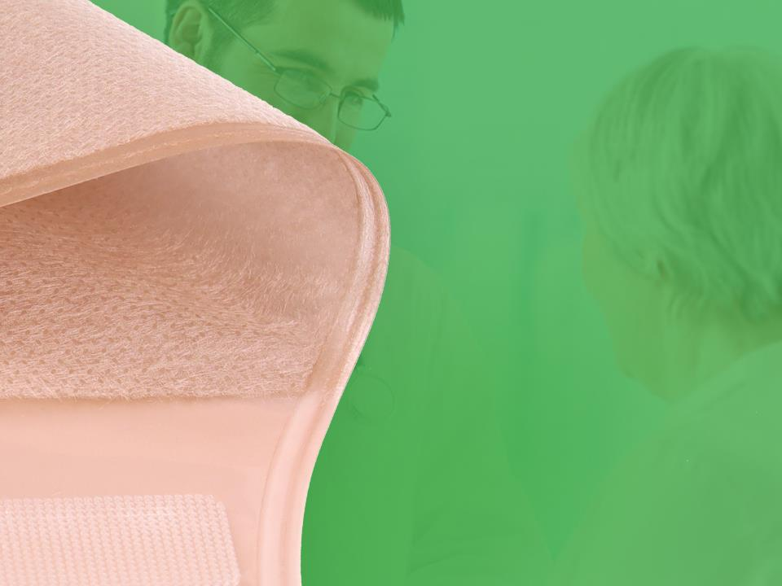
Outer Lining Non-woven
Fabric
Ultra-thin non-woven fabric, soft and comfortable
Waterproof fabric that stays fresh for a long time
Two colors available: skin color and white color

Slide 14
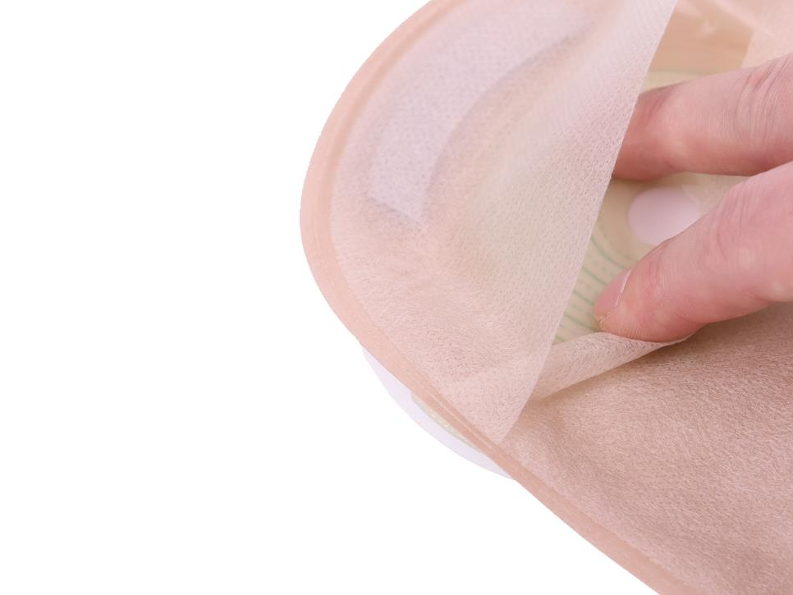
View Port
The hidden stoma observation window is convenient for doctors and patients to observe the stoma
Larger viewing windows for better visibility

Slide 15
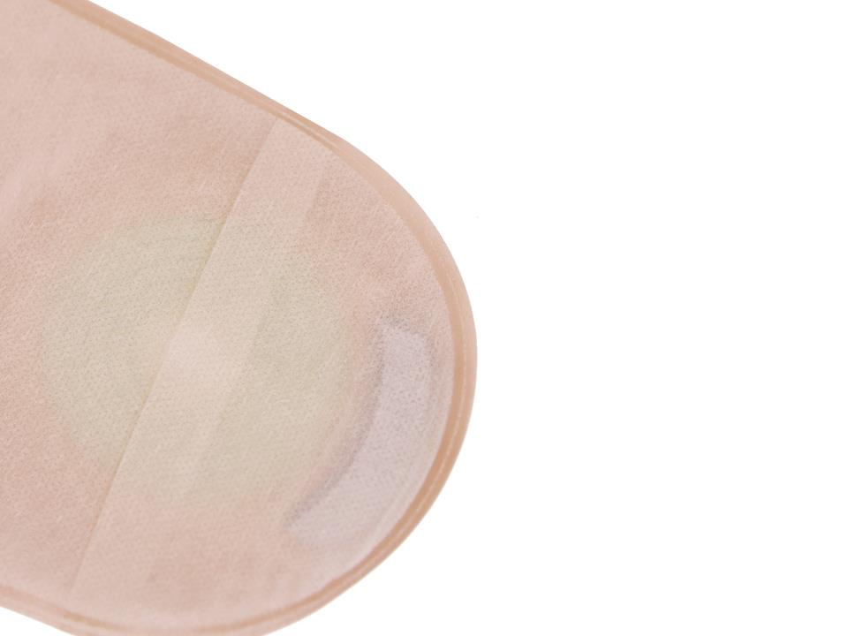
Activated Carbon Filter
Using activated carbon filter to reduce odor
The activated carbon filter of ILIFECARE design is absorbs odor effectively
It means giving a better comfort and greater confidence to patients

Slide 16



Schematic diagram of the filtration process
The gas will enter through the air intake, and then exit through the exhaust port.
Meanwhile,there is an S cut on the high-barrier film, which may appear on the left or on the middle, and its function is to better exhaust the gas and prevent bag swelling.

Slide 17

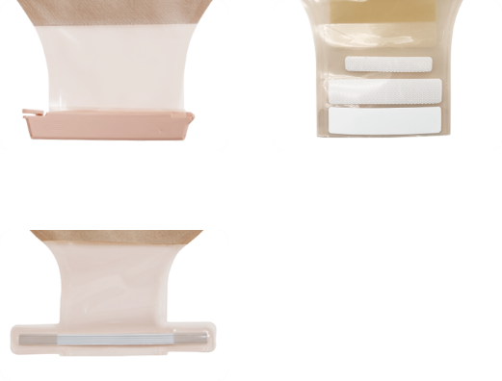
A Variety Of Sealing Methods Are Available
Clip closure
Velcro closure
Twist Tie Closure

Slide 18
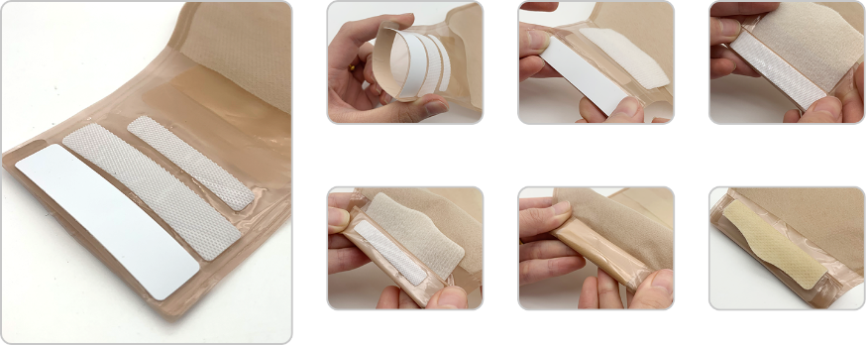
Detailed steps for sealing
Velcro closure

Slide 19
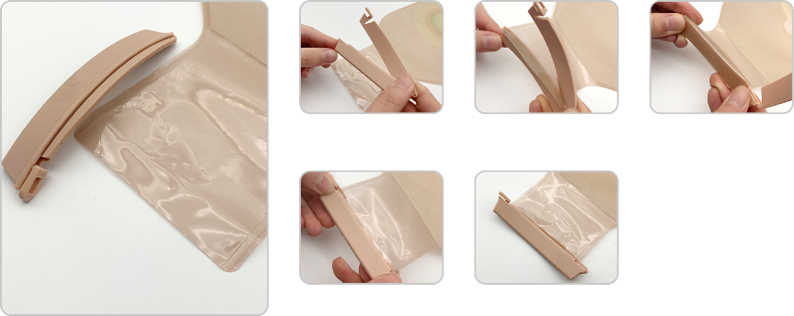
Detailed steps for sealing
Clip closure

Slide 20
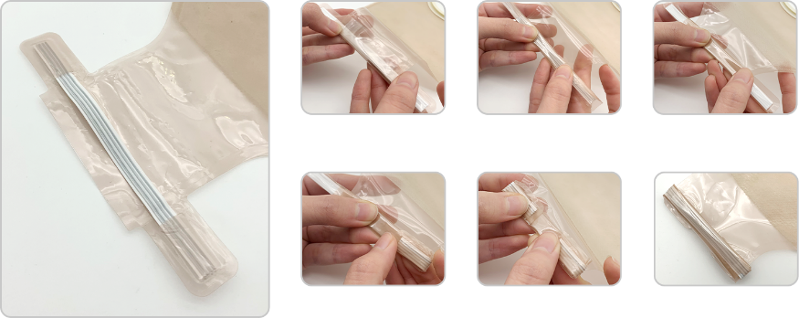
Detailed steps for sealing
Twist Tie closure

Slide 21

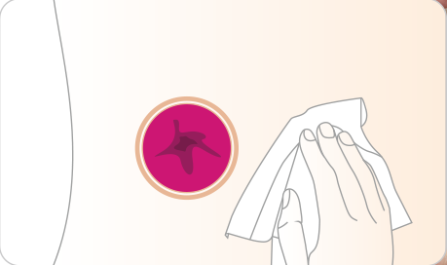
User Guide For One-piece Open Ostomy Bag
1. Wash the skin around the stoma with warm water
or saline and wait for the skin to dry.

Slide 22

User Guide For One-piece Open Ostomy Bag
2. Measure your stoma and cut the barrier to the
appropriate size/shape.

Slide 23
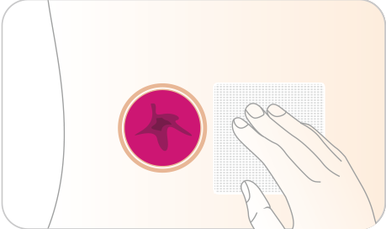
User Guide For One-piece Open Ostomy Bag
3. You can choose to place gauze on the stoma to
prevent feces and exudates from flowing out when
pasting the hydrocolloid barrier.

Slide 24
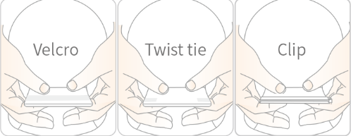
User Guide For One-piece Open Ostomy Bag
4. Close the ostomy bag with the Clip or Twist tie or Velcro.

Slide 25
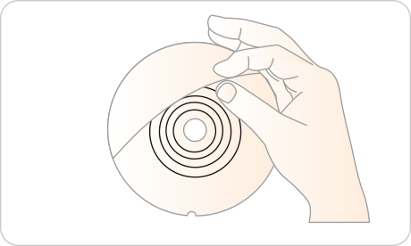
User Guide For One-piece Open Ostomy Bag
5. Peel off the PET protective film from the barrier to expose the hydrocolloid adhesive.

Slide 26
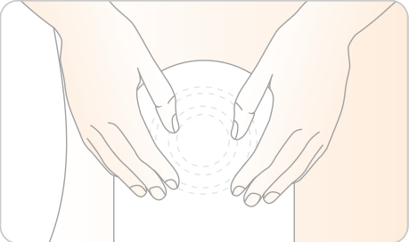
User Guide For One-piece Open Ostomy Bag
6. Let a small amount of air enter the bag to prevent the
ostomy bag from sticking together during use. Align
the hydrocolloid barrier with the stoma and apply
pressure so that it adheres completely to the skin.

Slide 27
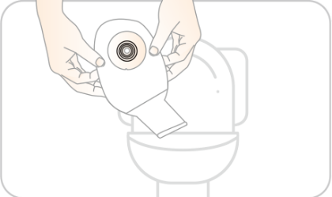
User Guide For One-piece Open Ostomy Bag
7. When the bag is full of feces, open the end of the
ostomy bag and drain the feces into the toilet. Wash
and dry the bag and continue to use the ostomy bag.

Slide 28
Caution
1. It is used in patients with a stoma.
2. Usually it can be used for 1 to 3 days, continuous use will affect the adhesion ability, it is recommended to replace it every day.
3. Ostomy bag can not be recycled..
4. The ostomy bag cannot be thrown directly into the toilet or sewer, nor can it be discarded at will. Please pay attention to environmental protection.
5. Patients allergenic to adhesive should use it with caution.

Slide 29


THANK YOU!
Shanghai Joy Crown Industry Co., Ltd

