Slide 1
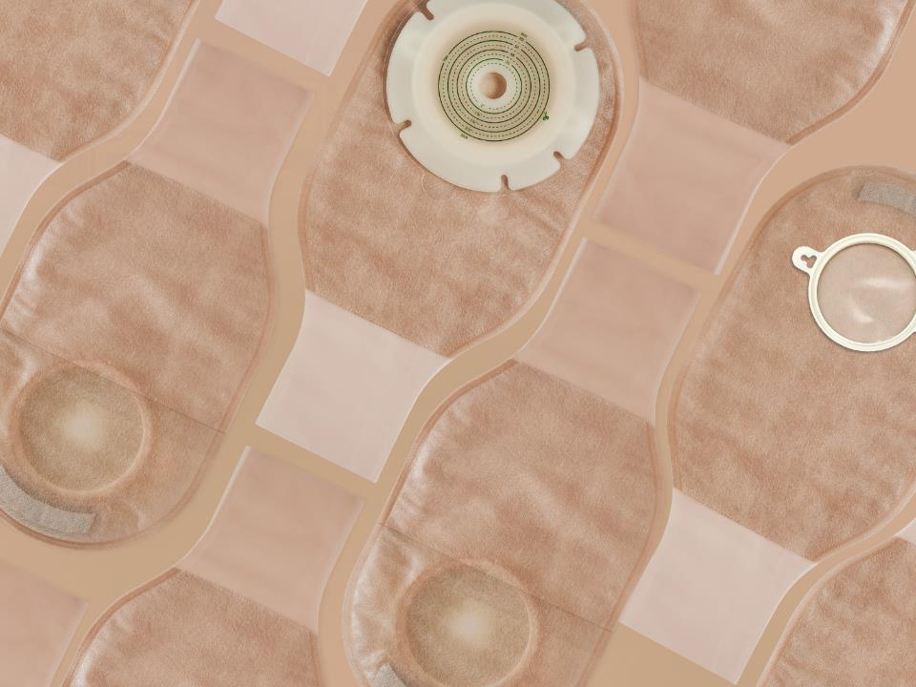

Ostomy Care Series
Two Piece Open Ostomy Bag
Shanghai Joy Crown Industry Co., Ltd

Slide 2


What is an ostomy?
People who have ostomy surgery, usually with disease or cancer of the large bowel or rectum. During clinical treatment, an opening in the abdomen will be surgically used as a drainage channel to replace the anus. This opening is called an artificial stoma or artificial anus, it is called a stoma.
If an artificial stoma is made due to a disease of the urinary system, it is called a urostomy.

Slide 3
What is an ostomy bag?
According to the different stoma, the ostomy bag can be divided into Colostomy bag and urostomy bag.
An ostomy bag is used to store feces excreted by a stoma patient through the stoma，The ostomy bag is composed of a barrier and a bag body, the barrier makes the ostomy bag stick to the human body, and the bag body is used to store feces.
The bag body and barrier can be one piece, which is called a one-piece ostomy bag. The bag body and barrier can also be split, which is called a two-piece ostomy bag.
The ostomy bag can be divided into an open pocket and a closed pocket. The open pocket can discharge feces at any time through the opening of the bag body, and the closed pocket can be discarded when it is full, which is convenient to use.

Slide 4
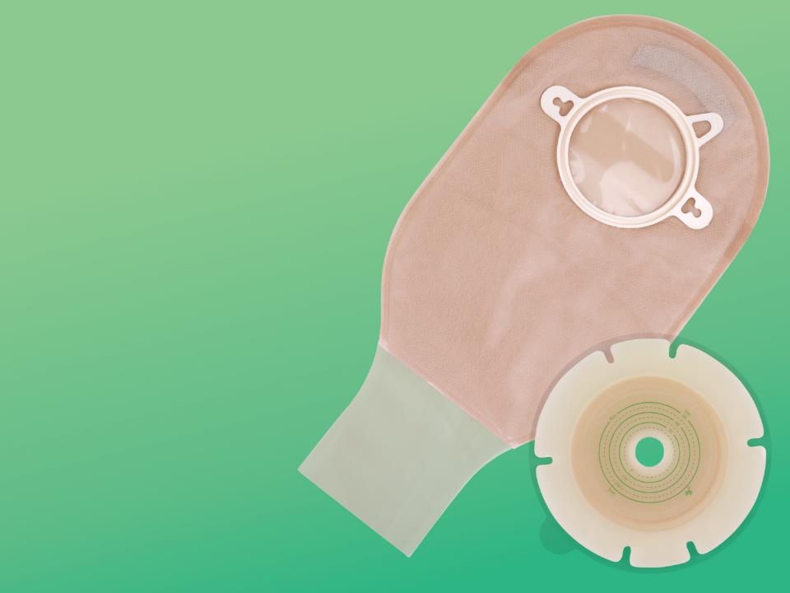
The Characteristics And Advantages Of Ilifecare Stoma Bag
snap ring
Hydrocolloid barrier with unique formula and special design
Soft and comfortable ultra-thin non-woven outer lining
Flexible, Sealed bag
Soft and tough plastic snap ring with good airtightness
Outer Lining Non-woven Fabric
Hydrocolloid Barrier
The Bag Body
The experiment shows that the product is frmly pasted and is not afraid of leakage

Slide 5
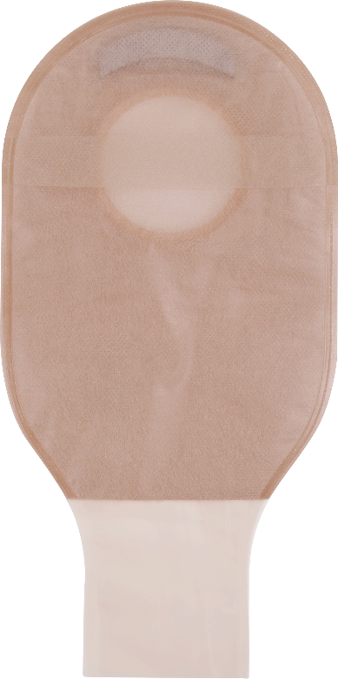

Activated Carbon Filter
5. Convenient observation
6. Activated carbon filter to effectively remove odors
7. Three sealing methods are availableodors
View Port
Sealing

Slide 6
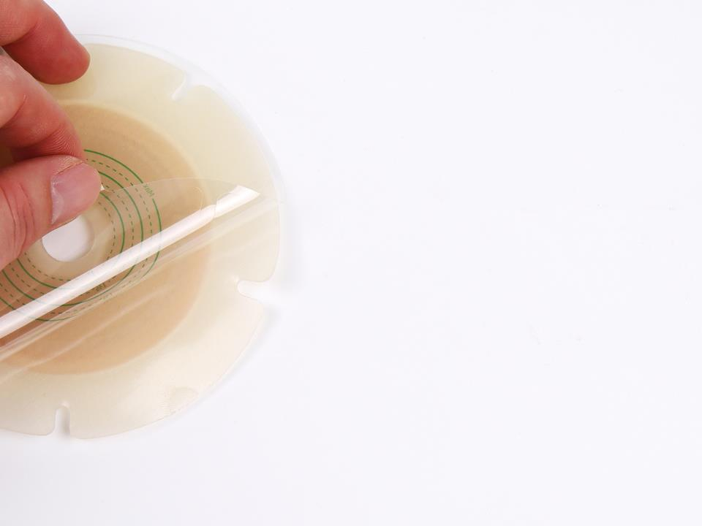
Hydrocolloid Barrier
Using medical hydrocolloid material, with no irritation and extremely low allergy rate.
Special hydrocolloid formula, with strong adhesive and safe and reliable.
Soft and comfortable, with radial incisions designed to conform to wrinkled skin with physical activity.
Easy to replace and clean.
Effectively absorbs the sweat produced by the skin, keeps it fresh and does not irritate the skin.

Slide 7


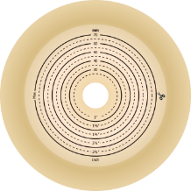
Three Barrier Styles To Fit Every Type Of Stoma
Hydrocolloid barrier
Hydrocolloid barrier
with tape border
Convex barrier

Slide 8
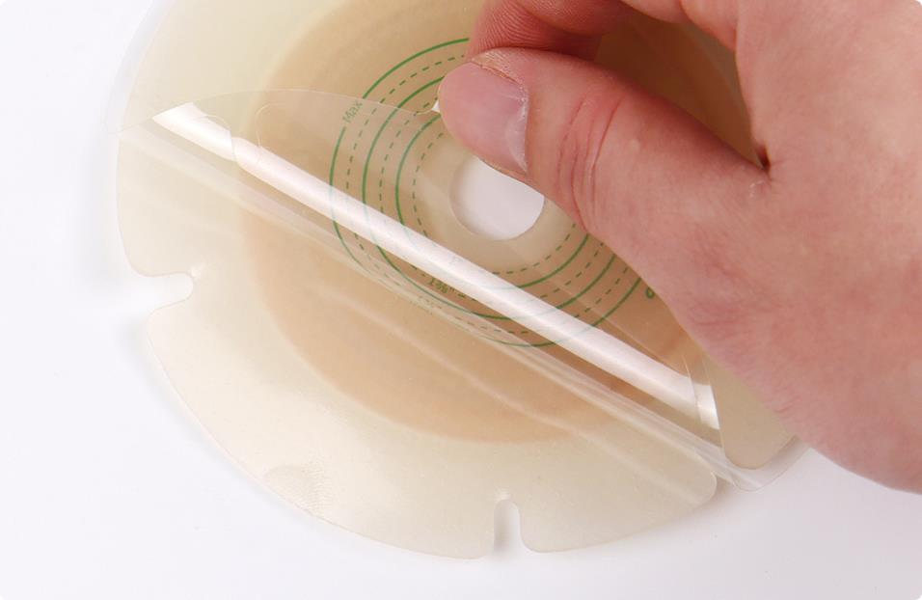
Hydrocolloid Barrier

Slide 9
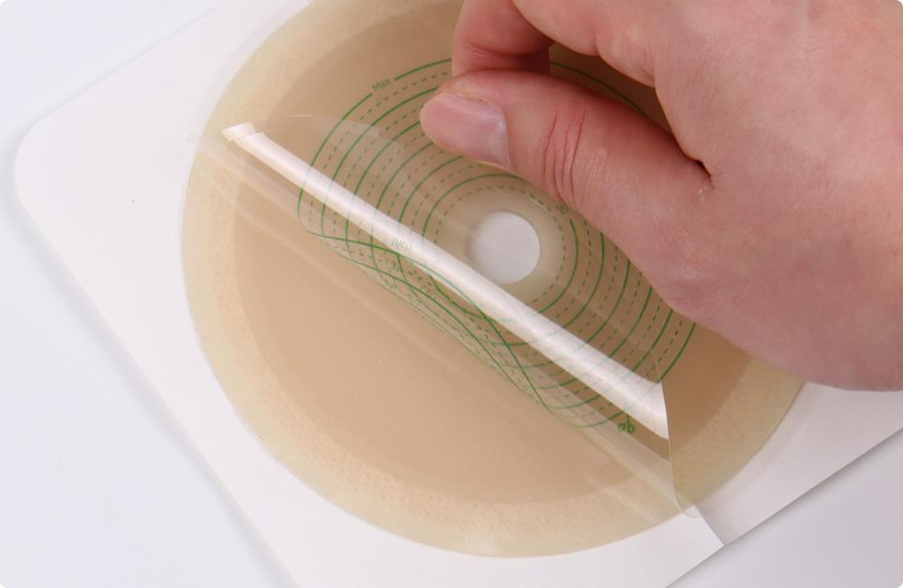
Hydrocolloid Barrier With Tape Border

Slide 10
Convex barrier

Slide 11


The Bag Body
* High barrier film, soft and strong
*Good airtightness and no leakage

Slide 12





A Variety Of Bag Styles Are Available For Patients Of Different Ages
Neonate
Children
Adult
Larger Size

Slide 13
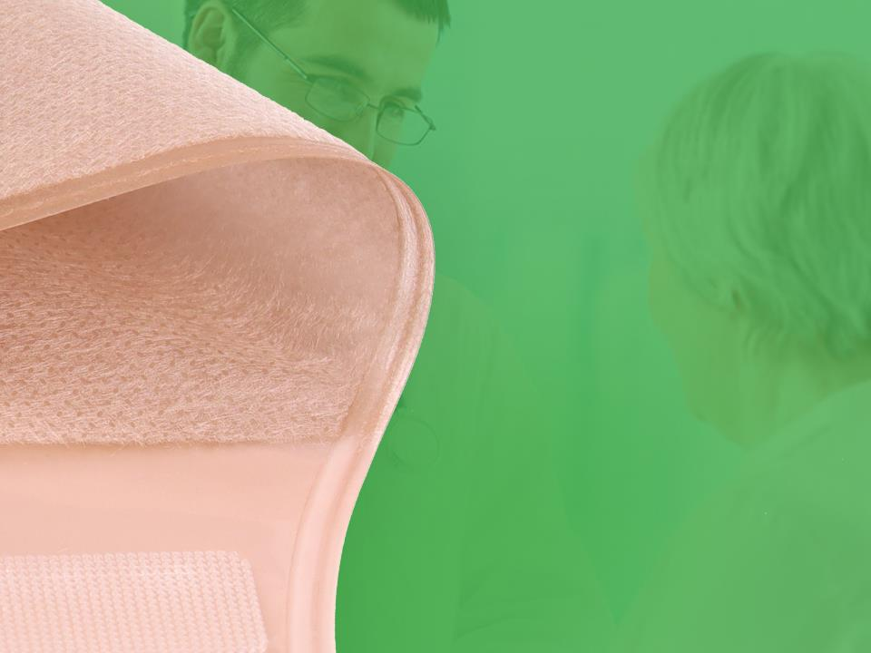
Outer Lining Non-woven
Fabric
Ultra-thin non-woven fabric, soft and comfortable
Waterproof fabric that stays fresh for a long time
Two colors available: skin color and white color

Slide 14
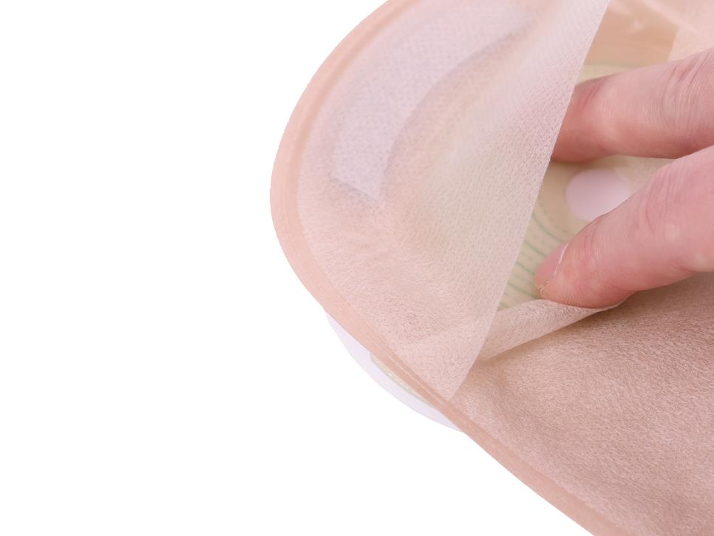
View Port
The hidden stoma observation window is convenient for doctors and patients to observe the stoma
Larger viewing windows for better visibility

Slide 15
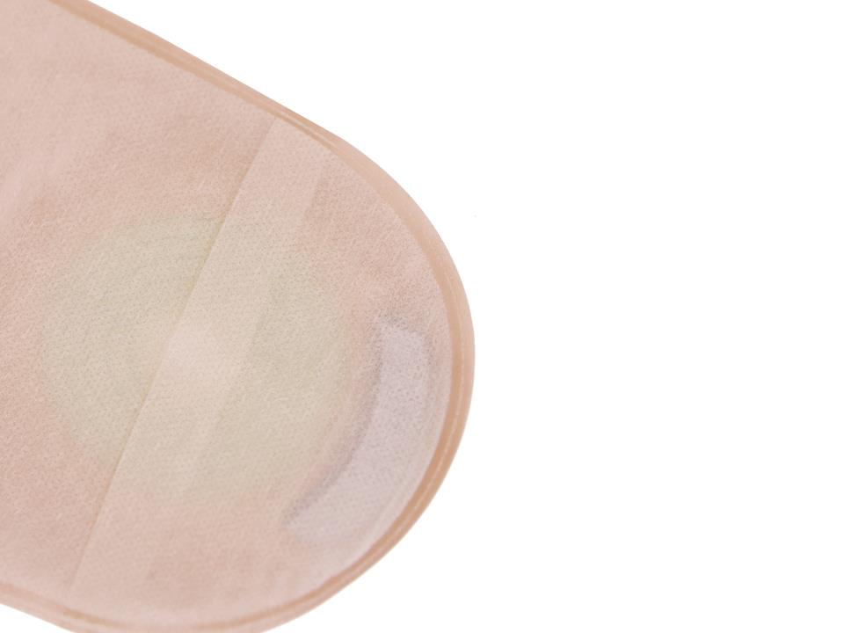
Activated Carbon Filter
Using activated carbon filter to reduce odor
The activated carbon filter of ILIFECARE design is absorbs odor effectively
It means giving a better comfort and greater confidence to patients

Slide 16



Schematic diagram of the filtration process
The gas will enter through the air intake, and then exit through the exhaust port.
Meanwhile,there is an S cut on the high-barrier film, which may appear on the left or on the middle, and its function is to better exhaust the gas and prevent bag swelling.

Slide 17

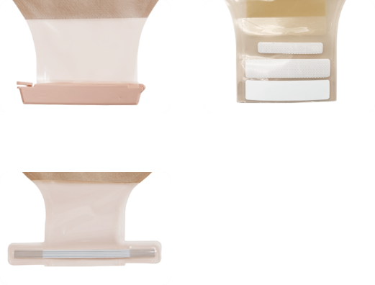
A Variety Of Sealing Methods Are Available
Clip closure
Velcro closure
Twist Tie Closure

Slide 18
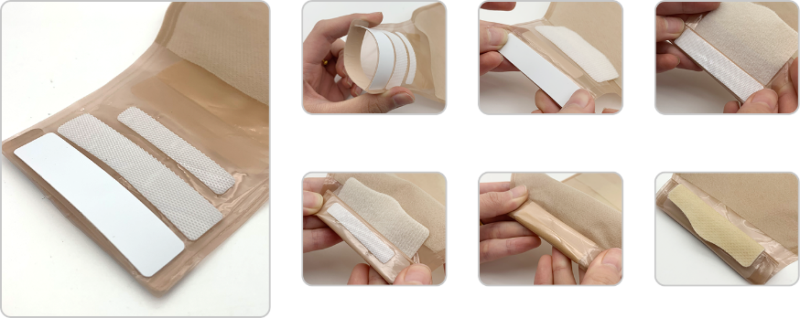
Detailed steps for sealing
Velcro closure

Slide 19
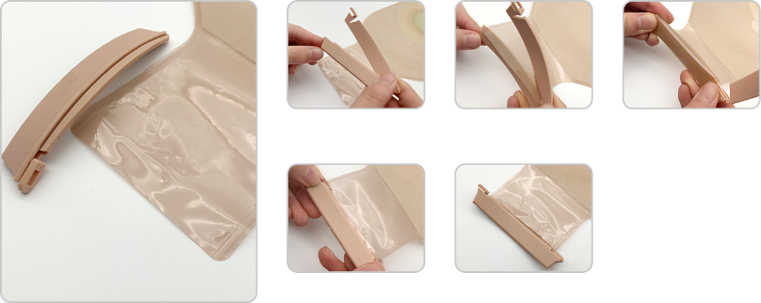
Detailed steps for sealing
Clip closure

Slide 20
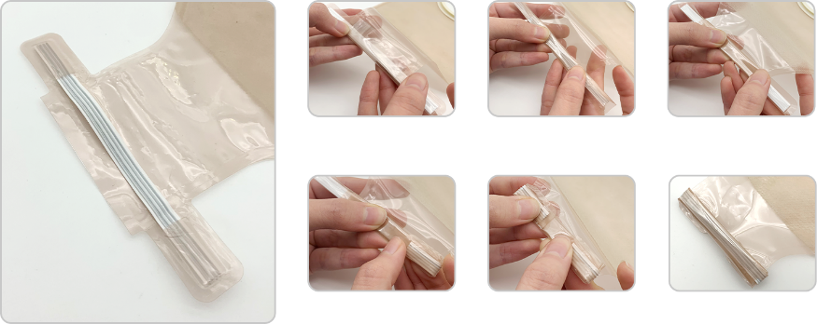
Detailed steps for sealing
Twist Tie closure

Slide 21

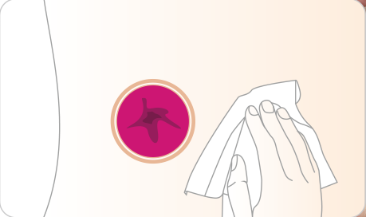
User Guide For Two-piece Open Ostomy Bag
1. Wash the skin around the stoma with warm water or
saline and wait for the skin to dry.

Slide 22

User Guide For Two-piece Open Ostomy Bag
2. Measure your stoma and cut the barrier to the appropriate size/shape.

Slide 23
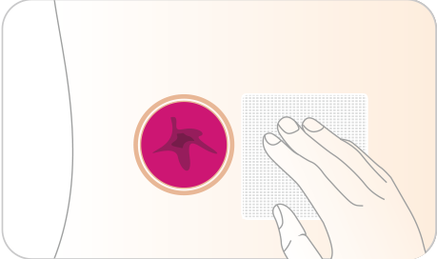
User Guide For Two-piece Open Ostomy Bag
3. You can choose to place gauze on the stoma to
prevent feces and exudates from flowing out when
pasting the hydrocolloid barrier.

Slide 24
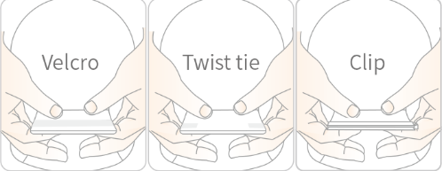
User Guide For Two-piece Open Ostomy Bag
4. Close the ostomy bag with the Clip or Twist tie or Velcro.

Slide 25
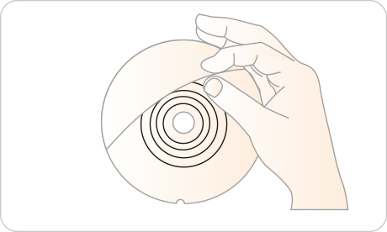
User Guide For Two-piece Open Ostomy Bag
5. Peel off the PET protective film from the barrier to
expose the hydrocolloid adhesive.

Slide 26
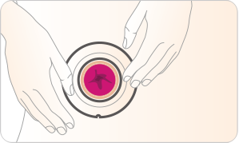
User Guide For Two-piece Open Ostomy Bag
6. Put the hydrocolloid barrier with the stoma and
apply pressure so that it adheres completely to
the skin.

Slide 27
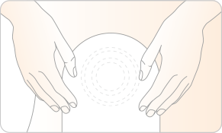
User Guide For Two-piece Open Ostomy Bag
7. Fix the bag on the hydrocolloid barrier, and pull the
bag to see if the two are securely combined.

Slide 28
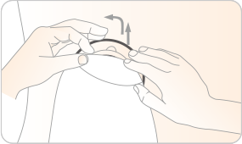
User Guide For Two-piece Open Ostomy Bag
8. Conveniently remove the bag through the pull ring
for cleaning or replacement.

Slide 29
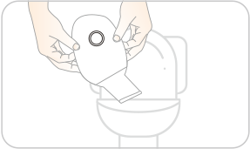
User Guide For Two-piece Open Ostomy Bag
9. When the bag is full of feces, open the end of the ostomy
bag and drain the feces into the toilet. Wash and dry the
bag and continue to use the ostomy bag.

Slide 30
Caution
1. It is used in patients with a stoma.
2. The hydrocolloid barrier can usually be used for 3 to 7 days, and continuous use will affect the adhesion ability. The bag can be reused after being cleaned.
3. The ostomy barrier cannot be reused.
4. The ostomy bag cannot be thrown directly into the toilet or sewer, nor can it be discarded at will. Please pay attention to environmental protection.
5. Patients allergenic to adhesive should use it with caution.

Slide 31

THANK YOU!
Shanghai Joy Crown Industry Co., Ltd

